Slide 1


2023
ML5G-PS-008: Network failure classification model using network digital twin
Team: MLAB_2023
Member: Tianhao Zhu

Slide 2
Outline
Introduction
Proposed Solution
Evaluation Result
Discussion
5
Conclusion and Future Consideration

Slide 3

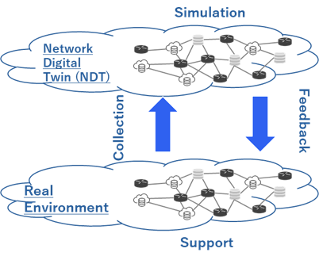
Introduction
Problem statement:
Network digital twin(NDT) is expected to address failure and mitigation to maintain high-level requirement for B5G. But it faces several challenges:
Hard to prepare the same network in NDT
Network behaviors simulated in NDT could be different from the real network, such as the number of failures
Challenge:
Conduct Root Cause Analysis on domain C (real network environment) using the training data on domain A (NDT environment) to construct a multi-classification model
结论总结与推广

Slide 4
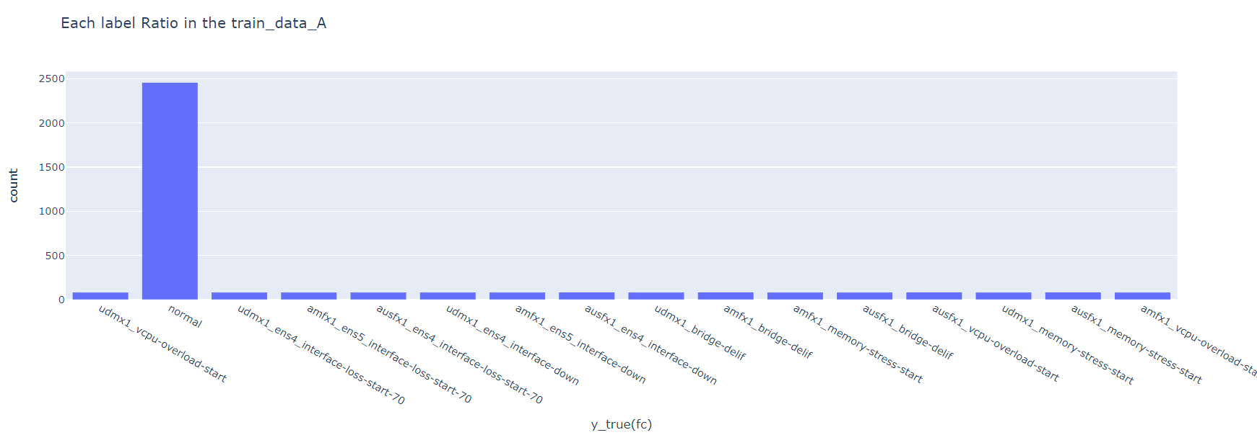
Introduction
Dataset overview
Features and labels
4118 features columns
15 failure labels and 1 normal label in total
Three dataset files in total: training-data_a collected from domain A, training-data_c and test-data_C from domain C.
The volume of training-data_a is much larger than that of training-data_c and testing-data_C
The number of normal labels is much larger than abnormal ones.
结论总结与推广

Slide 5
Proposed solution
Solution Summary
Data cleaning
Normalize the input features and encode the output labels
MLP-based transfer learning
Novel way of feature selection and further improvement
Calculate the mutual information between each feature columns and label column and rank the feature importance
Select the smallest number of features we need to achieve a good performance
Eliminate all the feature columns with only one value, since they have little contribution to the result of prediction. The number of remaining features is 1965
Sample the feature numbers from 0 to 1900 and compare their performance of average F1 score
Check for null values and outliers in dataset.
Adopt Multi-layer Perceptron (MLP) to construct the neural network model
Pretrain the network in domain A and fine-tune the last layer of the network by training data from domain C
结论总结与推广

Slide 6
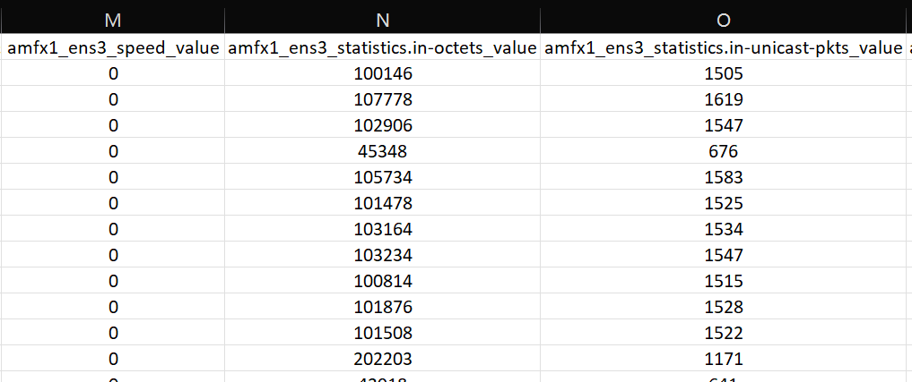
Proposed solution
Data cleaning
Normalize the input
Method
Conduct Min-Max scaling for normalization
Reason
The value in lots of features columns come from different scale as shown in the figure
Accelerate the speed of training and increase accuracy
Purpose
$$x_{scale}= \frac{x−x_{min}}{x_{max}−x_{min}}$$
𝑥_𝑠𝑐𝑎𝑙𝑒= (𝑥−𝑥_𝑚𝑖𝑛)/(𝑥_𝑚𝑎𝑥−𝑥_𝑚𝑖𝑛 )
结论总结与推广

Slide 7
Proposed solution
(2) MLP-based transfer learning
Method
Construct a Multi-layer Perceptron (MLP) neural network with two hidden layers.
Pre-train the MLP network using all the data from training-data_a
Freeze all the layer of the network except for the last one. Fine-tune the last layer of MLP with training-data_c
Only fine-tune the last layer with train_C
Strengths
High flexibility
More powerful generation ability
Much easier to adopt transfer learning
结论总结与推广

Slide 8
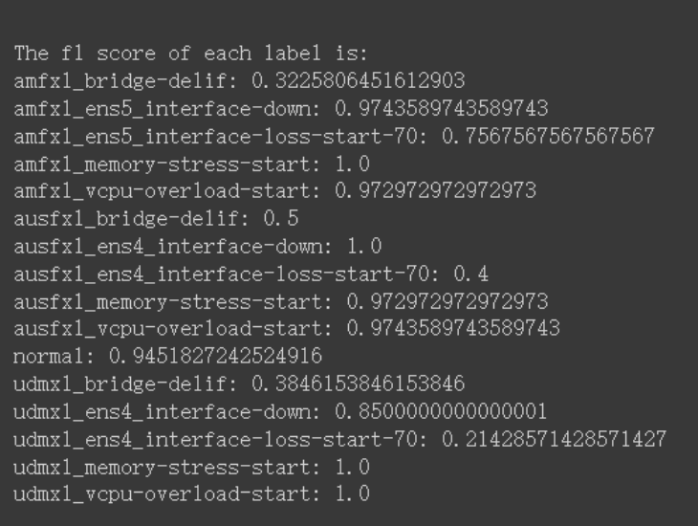
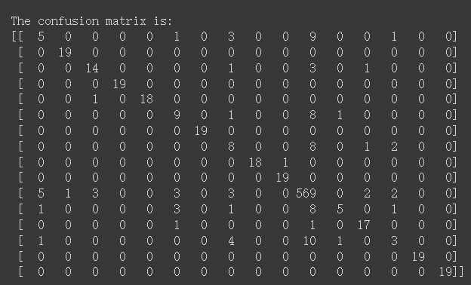
Proposed solution
(2) MLP-based transfer learning
Performance
Weakness
Need more training time
Some of the features of less importance might even compromise the model
结论总结与推广

Slide 9
Proposed solution
(3) Feature selection and further improvement
Feature selection based on mutual information
Calculate the mutual information between each feature column and label column
The larger the mutual information is, the higher the feature importance is.
$$I\left(X;Y\right)= \sum_{x∈X}{\sum_{y∈Y}{p\left(x,y\right)log\frac{p(x,y)}{p\left(x\right)p(y)}}}$$
𝐼(𝑋;𝑌)= ∑_(𝑥∈𝑋)▒∑_(𝑦∈𝑌)▒〖𝑝(𝑥,𝑦)𝑙𝑜𝑔 (𝑝(𝑥,𝑦))/(𝑝(𝑥)𝑝(𝑦))〗
According to the feature importance ranking result, we sample the number of selected features from top 10 to top 1900 and evaluate their performance of average F1 score.
结论总结与推广

Slide 10
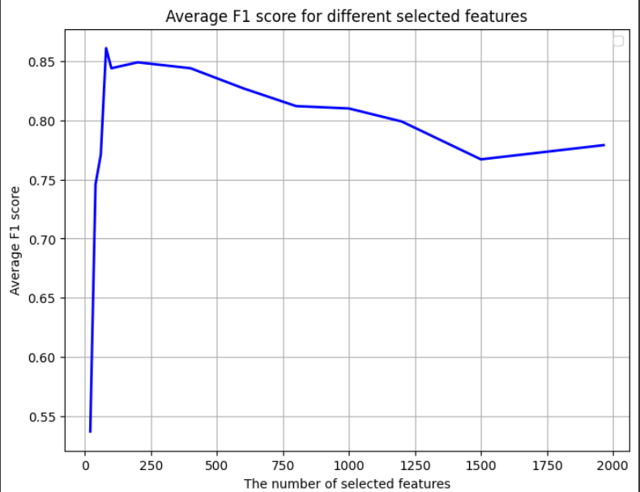
Proposed solution
(3) Feature selection and further improvement
Selected features examples (Important features)
amfx1_ens3_statistics.in-octets_value
amfx1_ens3_statistics.in-unicast-pkts_value
amfx1_ens3_statistics.out-octets_value
amfx1_load-avg-minutes.load-avg-minute-1.average_value
udmx1_memory-stats.free-percent_value
udmx1_per-core-stats.per-core-stat.user_value
After multiple calculation, we decide to select the top 100 features to train the model
结论总结与推广

Slide 11
Evaluation Result
amfx_1_bridge_delif
amfx1_ens_interface_down
amfx1_ens5_interface-loss-start-70
amfx1_memory-stress-start
amfx1_vcpu-overload-start
ausfx1_bridge-delif
ausfx1_ens4_interface-down
ausfx1_ens4_interface-loss-start-70
ausfx1_memory-stress-start
ausfx1_vcpu-overload-start
normal
udmx1_bridge-delif
udmx1_ens4_interface-down
udmx1_ens4_interface-loss-start-70
udmx1_memory-stress-start
udmx1_vcpu-overload-start
8 |  |  |  |  | 3 |  |  |  |  | 6 |  |  | 2
 | 19
 |  | 18 |  |  | 1
 |  |  | 19
 |  |  |  | 19
4 |  |  |  |  | 9 |  |  |  |  | 5 |  |  | 1
 |  |  |  |  |  | 19
2 |  |  |  |  |  |  | 11 |  |  | 5 | 1
 |  |  |  |  |  |  | 1 | 18
 |  |  |  |  |  |  |  |  | 19
3 |  | 1 |  |  | 2 |  |  |  |  | 579 | 1 |  | 2
2 |  |  |  |  |  |  |  |  |  | 4 | 13
 |  |  |  |  |  |  |  |  |  |  |  | 19
 |  |  |  |  |  |  |  |  |  | 5 |  |  | 14
 |  |  |  |  |  |  |  |  |  |  |  |  |  | 19
 |  |  |  |  |  |  | 1 |  |  | 1 |  |  |  |  | 17
Normal task: Use 100% of train_C data
结论总结与推广

Slide 12
Evaluation Result
Normal task: Use 100% of train_C data
Labels | F1 score
amfx_1_bridge-delif | 0.421053
amfx1_ens5_interface-down | 1.0
amfx1_ens5_interface-loss-start-70 | 0.947368
amfx1_memory-stress-start | 1.0
amfx1_vcpu-overload-start | 1.0
ausfx1_bridge-delif | 0.529411
ausfx1_ens4_interface-down | 1.0
ausfx1_ens4_interface-loss-start-70 | 0.6875
ausfx1_memory-stress-start | 0.972973
ausfx1_vcpu-overload-start | 1.0
normal | 0.970622
udmx1_bridge-delif | 0.764706
udmx1_ens4_interface-down | 1.0
udmx1_ens4_interface-loss-start-70 | 0.736842
udmx1_memory-stress-start | 1.0
udmx1_vcpu-overload-start | 0.944444
Average F1 score | 0.873435
结论总结与推广

Slide 13
Evaluation Result
amfx_1_bridge_delif
amfx1_ens_interface_down
amfx1_ens5_interface-loss-start-70
amfx1_memory-stress-start
amfx1_vcpu-overload-start
ausfx1_bridge-delif
ausfx1_ens4_interface-down
ausfx1_ens4_interface-loss-start-70
ausfx1_memory-stress-start
ausfx1_vcpu-overload-start
normal
udmx1_bridge-delif
udmx1_ens4_interface-down
udmx1_ens4_interface-loss-start-70
udmx1_memory-stress-start
udmx1_vcpu-overload-start
4 |  |  |  |  | 2 |  | 1 |  |  | 12 |  |  | 2
 | 19
 |  | 15 |  |  | 1 |  |  |  |  | 3 |  |  | 1
 |  |  | 17 |  |  |  |  |  |  | 2
 |  |  |  | 17 |  |  |  |  |  | 2
4 |  |  |  |  | 1 |  |  |  |  | 14 |  |  | 1
1 |  |  |  |  |  | 8 |  |  |  | 10
3 |  |  |  |  |  |  | 7 |  |  | 8 | 1
 |  |  |  |  |  |  |  | 17 |  | 2
 |  |  |  |  |  |  |  |  | 18 | 1
6 |  | 2 |  |  |  |  |  |  |  | 580
10 |  |  |  |  |  |  |  |  |  | 4 | 5
 |  |  |  |  |  |  |  |  |  |  | 7 | 11 |  | 1
 |  |  |  |  |  |  |  |  |  | 3 |  |  | 16
 |  |  |  |  |  |  |  |  |  |  |  |  |  | 19
 |  |  |  |  |  |  |  |  |  | 2 |  |  |  |  | 17
Advanced task: Use 10% of train_C data
结论总结与推广

Slide 14
Evaluation Result
Advanced task: Use 10% of train_C data
Labels | F1 score
amfx_1_bridge-delif | 0.170213
amfx1_ens5_interface-down | 1.0
amfx1_ens5_interface-loss-start-70 | 0.833333
amfx1_memory-stress-start | 0.944444
amfx1_vcpu-overload-start | 0.944444
ausfx1_bridge-delif | 0.090909
ausfx1_ens4_interface-down | 0.592593
ausfx1_ens4_interface-loss-start-70 | 0.518519
ausfx1_memory-stress-start | 0.944444
ausfx1_vcpu-overload-start | 0,972972
normal | 0.942323
udmx1_bridge-delif | 0.3125
udmx1_ens4_interface-down | 0.733333
udmx1_ens4_interface-loss-start-70 | 0.888889
udmx1_memory-stress-start | 0.974359
udmx1_vcpu-overload-start | 0.944444
Average F1 score | 0.737983
结论总结与推广

Slide 15
Evaluation Result
Training data: 100% of training-data_a and 100% of training-data_c
Average F1 score: 0.873435
Training data: 100% of training-data_a and 10% of training-data_c
Average F1 score: 0.737982
Normal task
Advanced task
Result summary
结论总结与推广

Slide 16
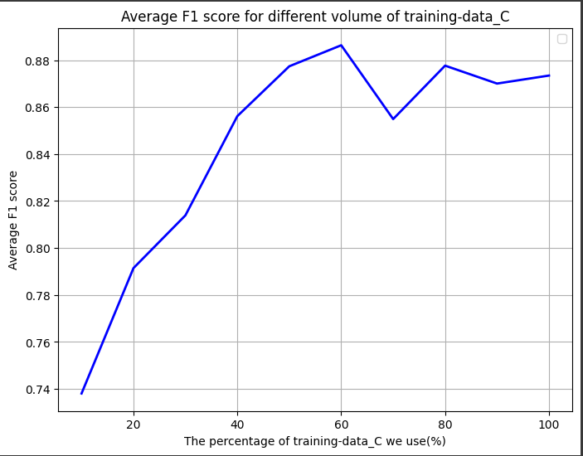
Evaluation Result
We further expand the advanced task by comparing the performance where we adopt different volume of training-data_c, from 10% to 100%, as the figure shown below.
结论总结与推广

Slide 17
Discussion
From the graph in the last slide, we can see that the curve is not monotonically increasing, which means that the growth of training data amount doesn’t necessarily lead to progress in performance. It might be due to the following reasons:
The training-data_c might contain noisy or incorrect data, which needs further work in data cleaning.
Larger volume of training-data_c could lead to overfitting to some extent
In most case, failure types of “interface down”, “memory stress” and “CPU overload” can achieve almost 100% accuracy and F1 score while the performance of “packet loss” is a bit relatively poorer.
“Bridge down” are the most easily misidentified failure type.
结论总结与推广

Slide 18
Conclusion and Future Consideration
Our work
The originality of our research lays on the novel way of data prepossessing by calculating the mutual information to conduct feature selection. It turns out that feature selection can not only reduce training time, but also greatly improve the performance of network.
Future consideration
Further data prepossessing: It includes data correlation research for poorly-performed labels like “bridge-down”, enhanced feature engineering such as new feature generation and other methods to conduct feature selection
Combining with the selected features, the MLP model we proposed can achieve a high F1 score for all failure types except for “bridge down”.
Model selection: Explore more options of models, especially tree-based mdoel. We evaluate the performance of CatBoost in this research, but its performance is even worse than MLP. Therefore, other tree-based models need to be further considered as well.
结论总结与推广

